Slide 1
Mobile Product Authentication & Add-on Services
Projecting Ag input manufactures and giving farmers a chance to increase their productivity

Slide 2
Problem Statement
Counterfeit farm inputs are one of the biggest threat to agriculture in Africa, affecting germination, crop health, food security, production and income;
Estimates suggest that 70% of the farmers are potentially exposed to fake inputs and 30/40% of seed and fertilizer are counterfeit;
If not properly and promptly addressed, it can lead to a low-technology trap

Slide 3
Problem Statement
Fake Inputs
Low productivity
Low fertility
Crop Diseases
Low Income
Farmer distrust

Slide 4
What can we do?
Governments cannot take concrete actions to eliminate the threats because of lack of a monitoring system;
An effective MS requires an integrated approach involving exchange of reliable and timeless information between farmers, manufacturers and authorities;
So far, efforts focused on apps for warning the farmers but no links with any monitoring system

Slide 5
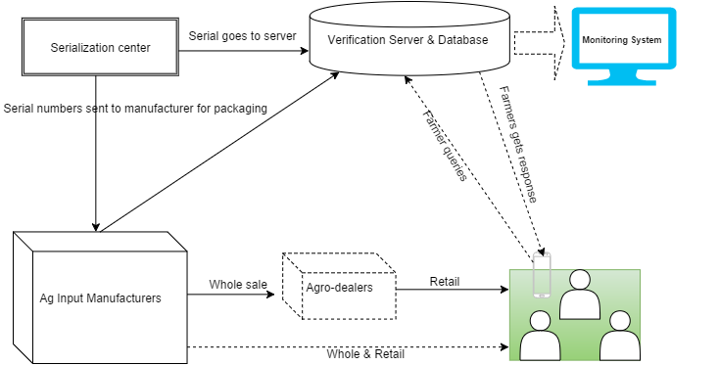
Our solution:

Slide 6
Reporting Matrix
Manufacture counterfeit score
Supplier counterfeit score - % of counterfeit
Product counterfeit score
Geographic location – hit map of detected counterfeit
Customer awareness and loyatily

Slide 7
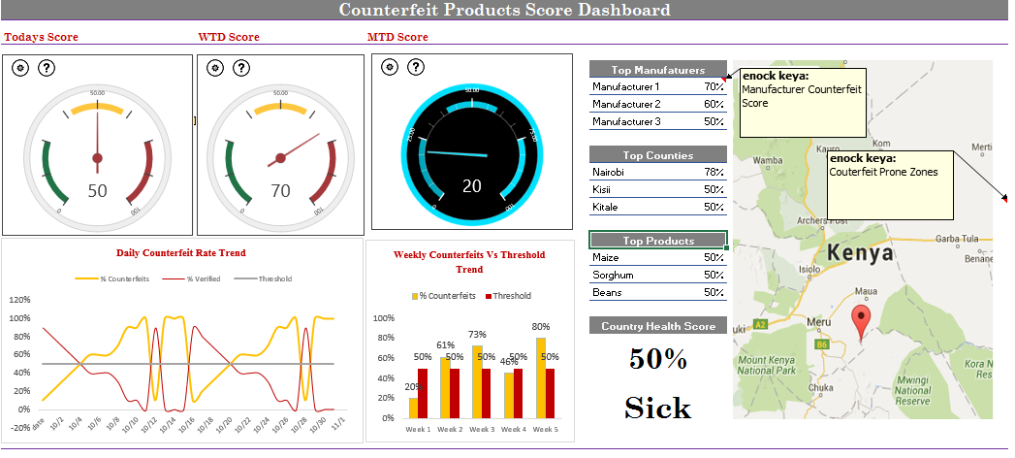
Reporting: Executive Dasboard

Slide 8
Double Bottom line…
Financial Viability and Impact:
Input manufacturers will be key source of revenue. We protect their brand and products.
Database has rich information on farmers that can be provided to others, like banks, MFIs, etc…
Farmers are also potential source of revenue
Some farmers can pay for the service ( using airtime)
Advertisements
2. Social Impact:
Reduce fake input from farmer’s fields. This may account for about 30-40% productivity gain.
Government can use monitoring system ( information from database) to provide other services
Encourage other manufacturers to enter the market, as they know they will make money. This leads to further competition and ultimately better input prices for farmers

Slide 9
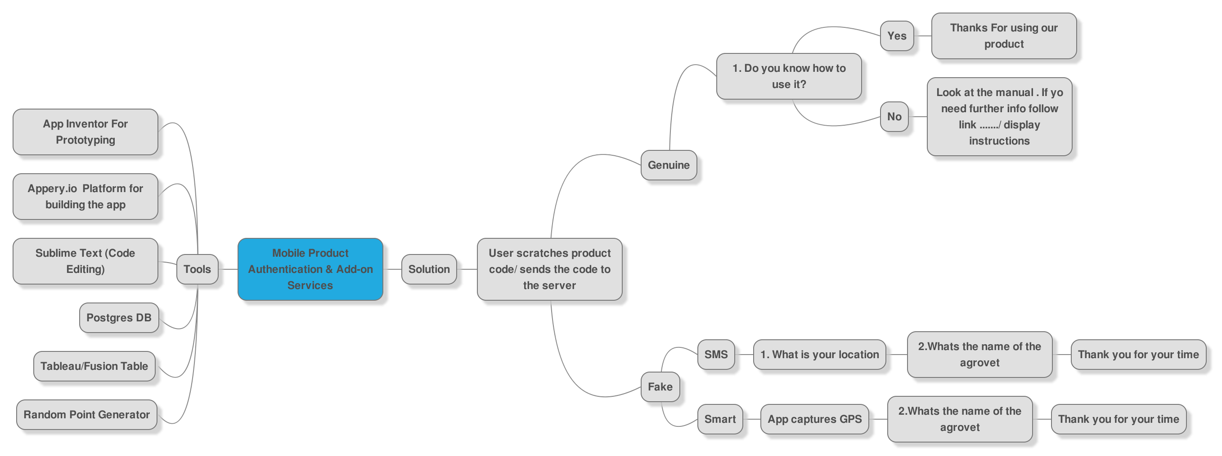
How it works in practice…Demo: *384*101#

Slide 10
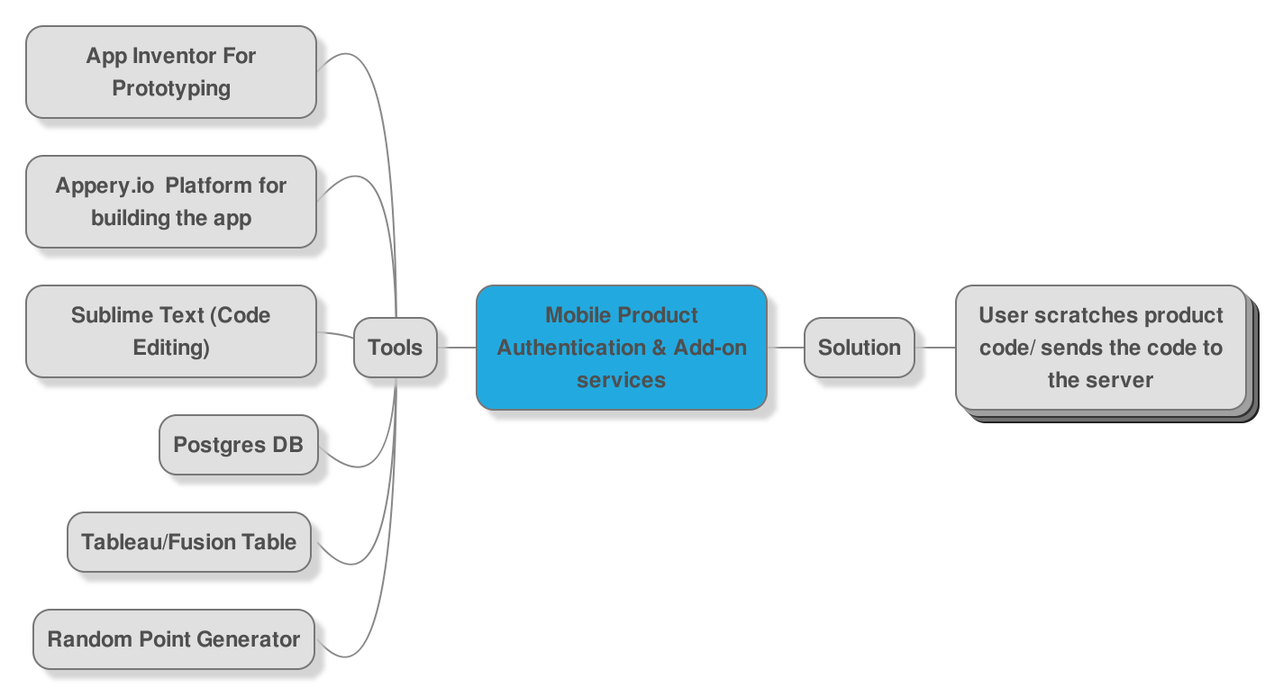
Tools
Codica
Mindmup
PHP

Slide 11
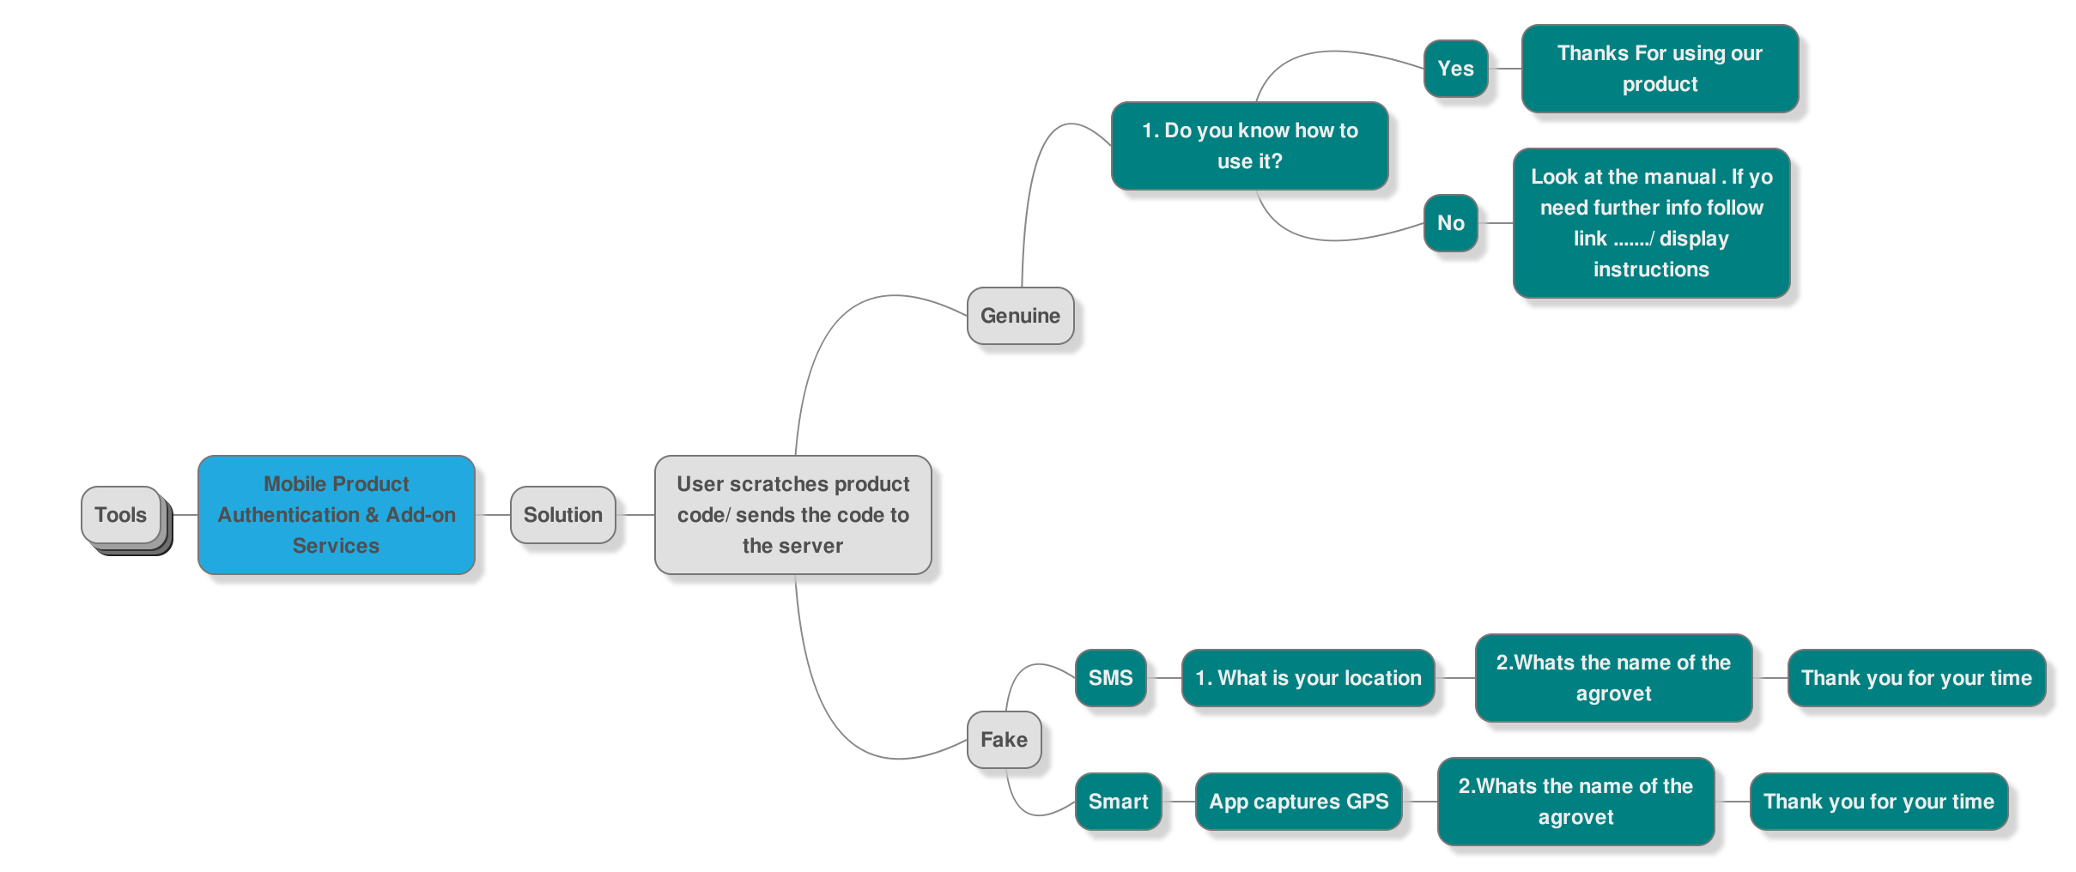
The innovation

Slide 12
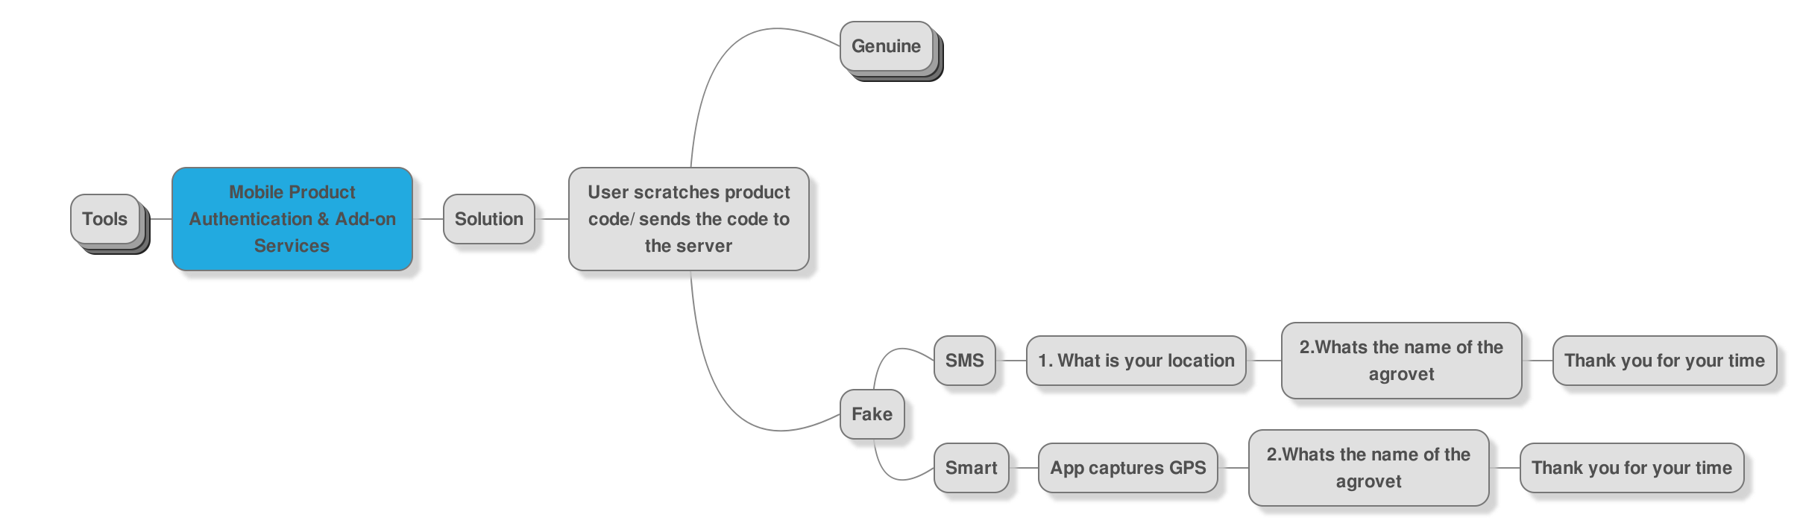
Outcome 2

Slide 13
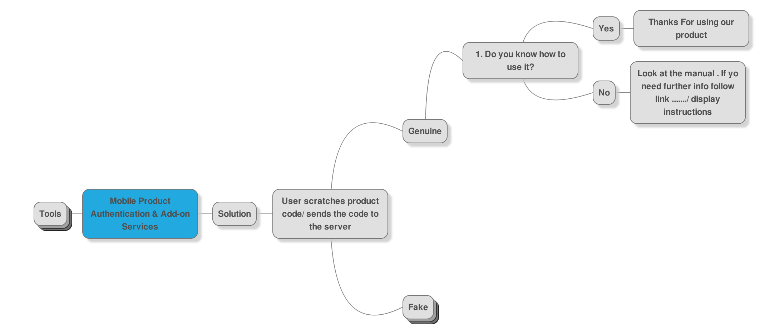
Outcome 1

Slide 14
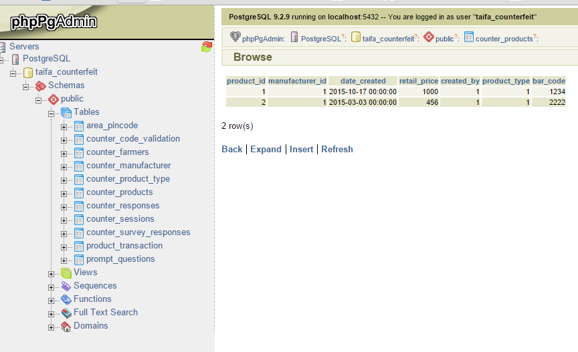

Slide 15
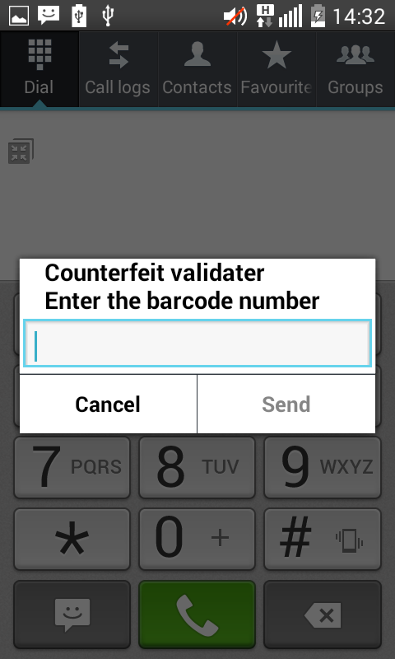
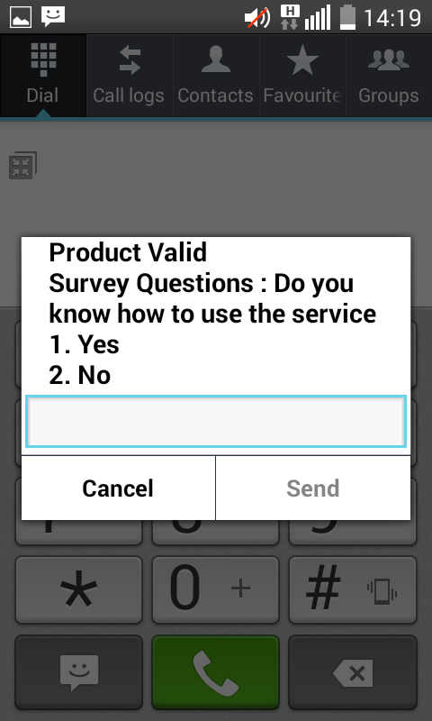
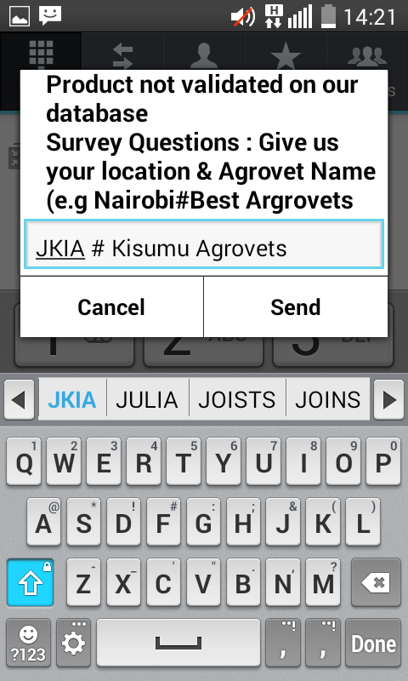
Basic phone – SMS solution (*384*101#)

Slide 16
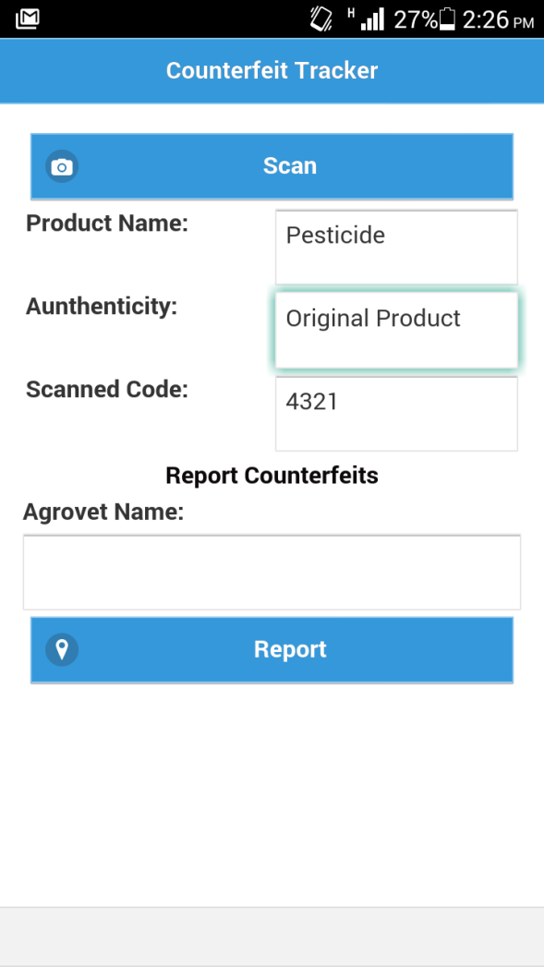
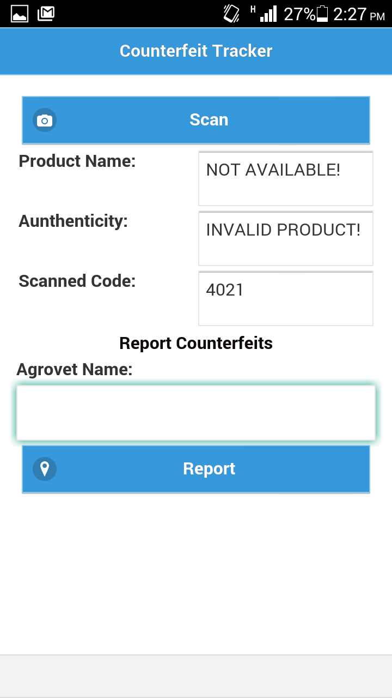
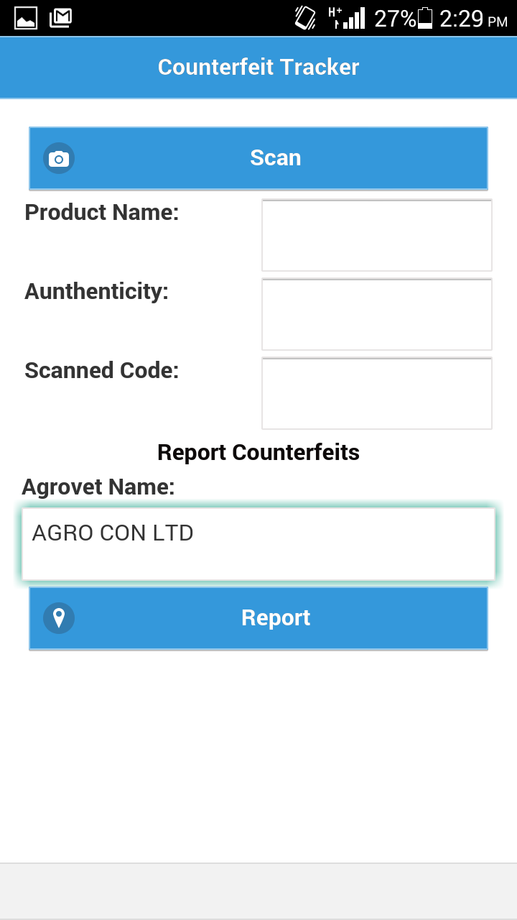
Smart phone - platform

Slide 17
THANK YOU!

